Slide 1


Slide 2
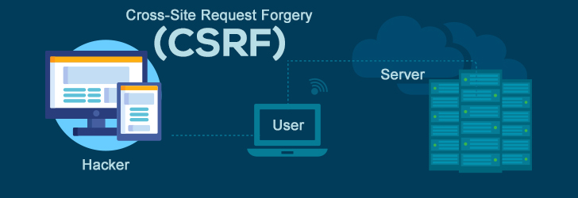


Slide 3
Agenda:
What is CSRF;
How CSRF Works;
Method of Attack;
Impact;
Mitigation;
Practical.

Slide 4
What are cookies?
Cookies are basically some small text files with a maximum of size 4KB that are stored over on the client’s browser in the form of name-value pair.
Cookies are majorly used to track or monitor the client’s activity on the web application and even stores some sensitive data such as username, session ID’s, password preferences, etc, which thus can be sent back to the server for an authentication request.

Slide 5
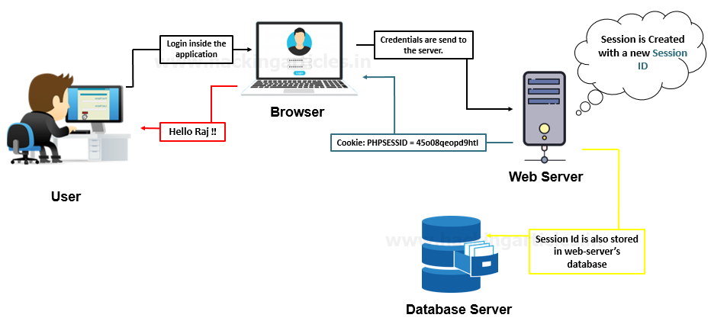
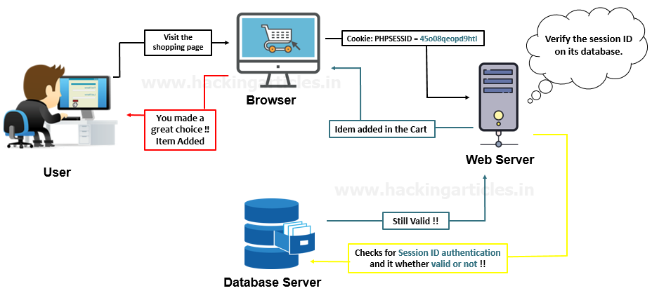
What are Session ID’s?
Similar to the cookies, sessions are some small files too, but they are generated and stored at the server’s end.
Each session is associated with a session ID. Whenever a user logs in, thus a session is created with a session ID, thereby this session ID blends up into the cookie and stored at the client’s browser and thus passed back to the web server whenever the browser makes an HTTP request.

Slide 6
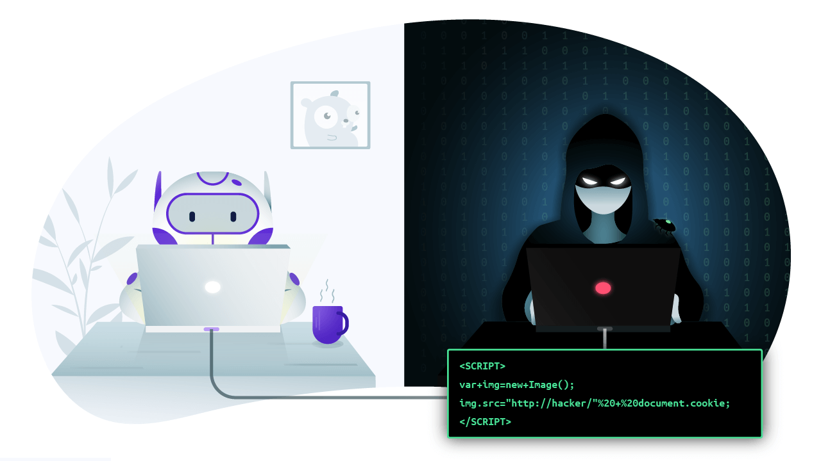
Cross-Site Request Forgery
CSRF is an attack vector that tricks a web browser into executing an unwanted action in an application to which a user is logged in.
It allows an attacker to carry out actions of the logged in user within an application.
A CSRF sends a HTTP request whenever a user opens a website containing malicious code to achieve its aim.

Slide 7
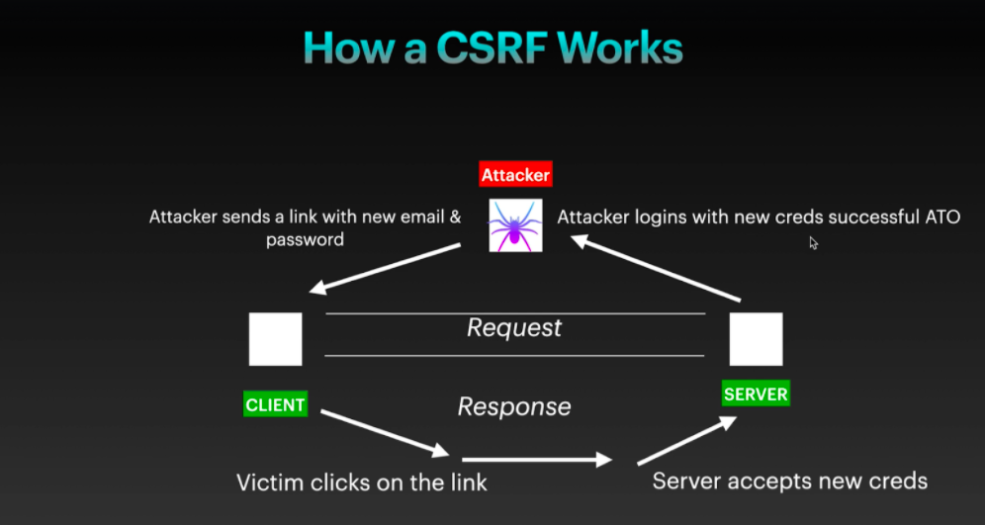

Slide 8
<html>
<body>
<form action="https://target.com/my-account/change-email" method="POST">
<input type="hidden" name="email" value="attacker@mail.com" />
<input type="submit" value="Submit request" />
</form></body>
</html>

Slide 9
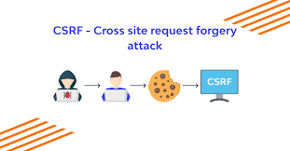
Testing CSRF Vulnerabilities:
Make 2 accounts, one is of victim and another of attacker.
Sign In with attacker account and generate a malicious link also called as CSRF POC.
Send the PoC / link to the victim.
Sign In with the victim's account and open the link.
If successful i.e. data changes, you proved the web application vulnerable to CSRF.
CSRF Severity:
CSRF is a critical vulnerability since an attacker can permanently take over a user's account.

Slide 10
impact:
CSRF is an attack that forces the victim or the user to execute a malicious request on the server on behalf of the attacker.
Although CSRF attacks are not meant to steal any sensitive data as the attacker wouldn’t receive any response as whatever the victim does but this vulnerability is defined as it causes a state change on the server, such as –
Changing the victim’s email address or password.
Purchasing anything.
Making a bank transaction.
Explicitly logging out the user from his account.

Slide 11
mitigation:
The developers should implement the use of “Anti-CSRF tokens”
Use of Same-Site cookies attributes for session cookies, which can only be sent if the request is being made from the origin related to the cookie (not cross-domain).
Do not use GET requests for state-changing operations.
Identifying Source Origin (via Origin/Referer header)
One-time Token should be implemented for the defence of User Interaction based CSRF.
Secure against XSS attacks, as any XSS can be used to defeat all CSRF mitigation techniques!

Slide 12
REFERENCE:
https://www.synopsys.com/glossary/what-is-csrf.html#:~:text=Cross%2DSite%20Request%20Forgery%20(CSRF)%20is%20an%20attack%20that,has%20in%20an%20authenticated%20user.
https://asfiyashaikh.medium.com/cross-site-request-forgery-csrf-8ce6f9ee0379
https://www.codecademy.com/learn/seasp-defending-node-applications-from-sql-injection-xss-csrf-attacks/modules/seasp-preventing-cross-site-request-forgery-csrf-attacks/cheatsheet
https://www.imperva.com/learn/application-security/csrf-cross-site-request-forgery/

Slide 13
thank you

